Slide 1
Outland Adventures
Shayla Bradley — Patrick Ellis — Yawa Hallo — Abigail Klein
Case Study Project: Problem Exploration, Explanation, and Solutions
Notes:
Assignment: Milestone #4
Prepare a presentation of your case study solution. Include a group introduction, a brief description of the case study, the finalized ERD, a description of the reports you decided to generate, an example of each report result, and any assumptions you made about the case study that informed your design decisions. Have one member of the group post the presentation to the Project Forum for the class to review.
Deliverable
The deliverables for this milestone should be posted to the Project Forum for the class.

Slide 2

Group Introduction
This case study project was conducted by the Silver Team which consists of four members—Shayla Bradley, Patrick Ellis, Yawa Hallo, and Abigail Klein.
Out of the three case studies (Bacchus, Outland Adventures, and Willson Financial), Team Silver chose to explore the Outland Adventures (OA) Case Study. The team chose the OA case study because the story connected with each member and the problems were intriguing. Venture into the story yourself on the next slide →
Notes:
group introduction

Slide 3


Outland Adventures
Outland Adventures was founded by outdoor lovers Blythe Timmerson and Jim Ford. They aimed to appeal to others who enjoyed going on long hikes and camping in remote locations. They believed that Outland Adventures might actually flourish if they could plan guided excursions, offer the necessary gear, and create the correct marketing.
To ensure their business was a success, Timmerson and Ford hired:
two (2) Guides who are in charge of organizing and planning the trips, including investigating airfares, visa requirements, and inoculations;
one (1) Marketer;
one (1) Supply Manager who is responsible for ordering supplies for the trips and keeping the equipment inventory up to date in which customers can either buy or rent; and
one (1) Web Developer who is responsible for developing an ecommerce site, checking on trip schedules, and purchasing hiking and camping equipment.
Notes:
brief description of the case study

Slide 4

Problems to Solve
To optimize the Outland Adventures’ procedures, Timmerson and Ford have a few questions that need to be answered:
Do enough customers buy equipment to keep equipment sales?
1
2
Are there inventory items that are over five years old?
2
Among the locations that Outland Adventures travels to (Africa, Asia, and Southern Europe), are there any that have a downward trend in bookings?
3
3
Notes:
brief description of the case study

Slide 5

SOLUTIONS

Slide 6

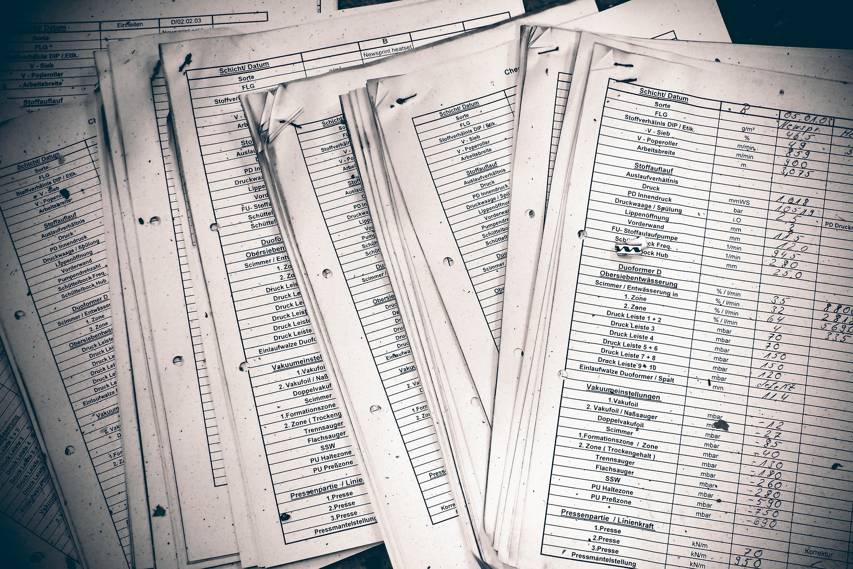
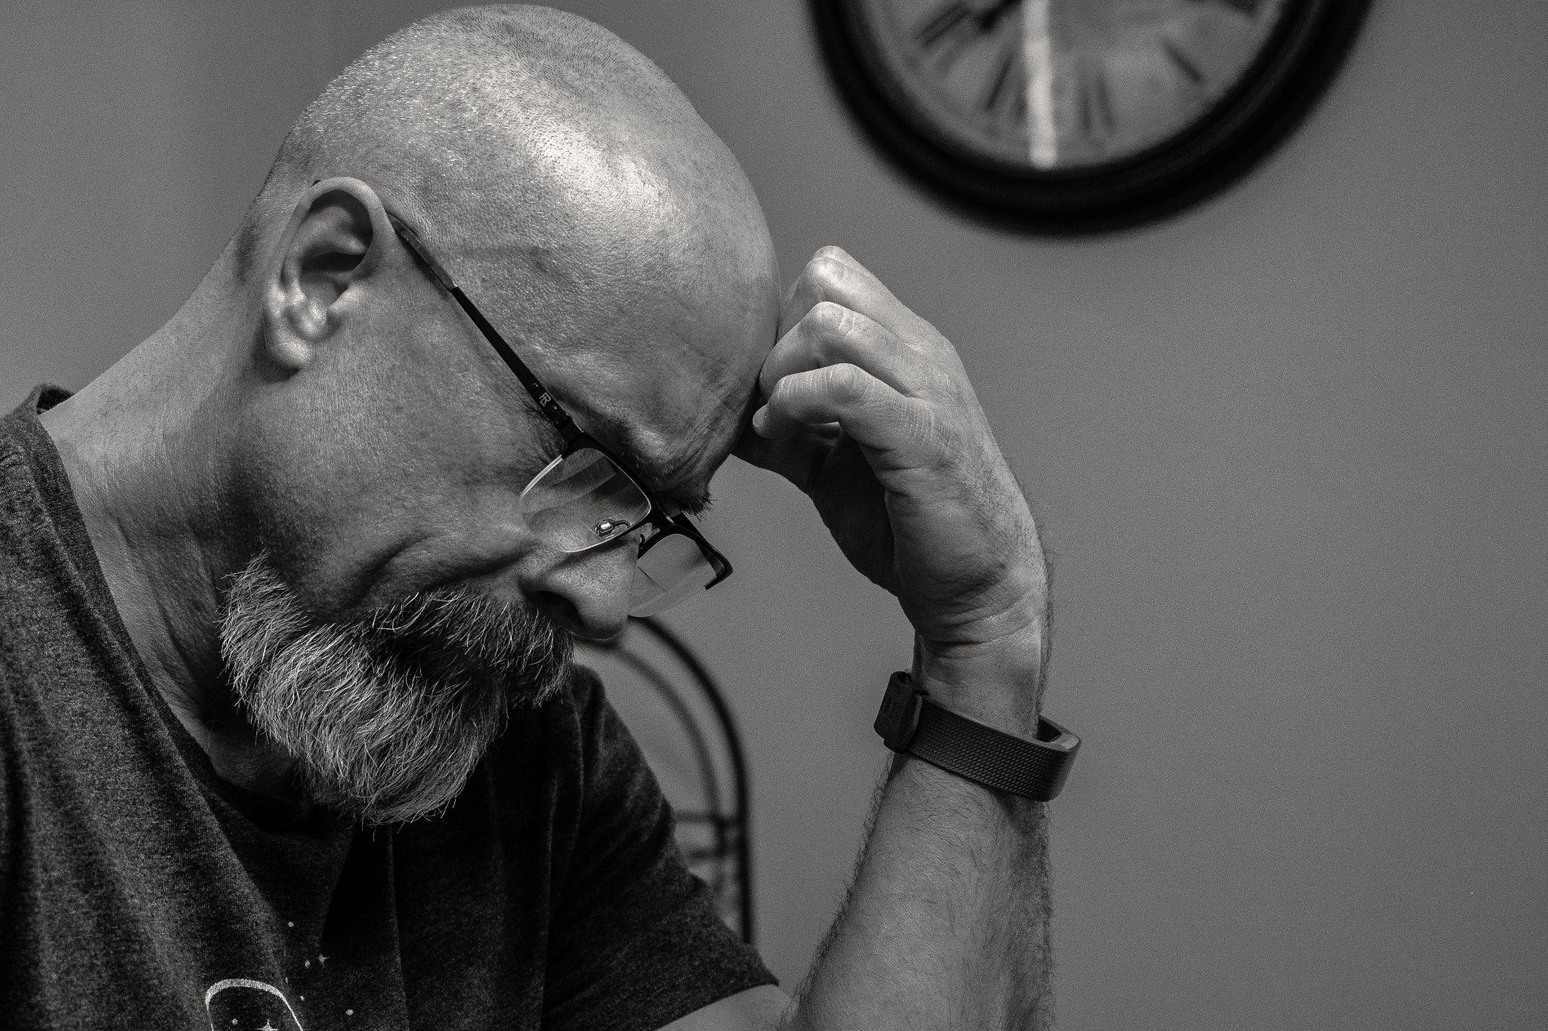
Assumptions
01 | Department table is needed to assign privileges to employees.
02 | We assume that all customers are living in the USA.
03 | Duke and Mac will be assigned to each booking individually by their employee ID.
04 | Customers can book more than one trip.
05 | Customer bookings will vary with airfare prices.
06 | Airfare will vary during different seasons.
07 | Visa requirements are based on any country within Asia, Africa, and Southern Europe.
08 | There will be multiple visa requirements for different trip locations.
09 | Multiple vaccinations will be required for different trip locations.
10 | Blythe and Jim need access to all tables.
11 | John ‘Mac’ and D.B. ‘Duke’ need access to the trips, airfare, visa requirements, and inoculations tables.
12 | Dimitrios needs access to the supply order, supplier info, and the equipment inventory tables.
13 | Anita Gallegos needs access to the trips and equipment tables.
14 | Mei Wong needs access to trips, bookings, equipment, airfare, visa requirements, and the inoculations tables.
Notes:
assumptions you made about the case study that informed your design decisions

Slide 7
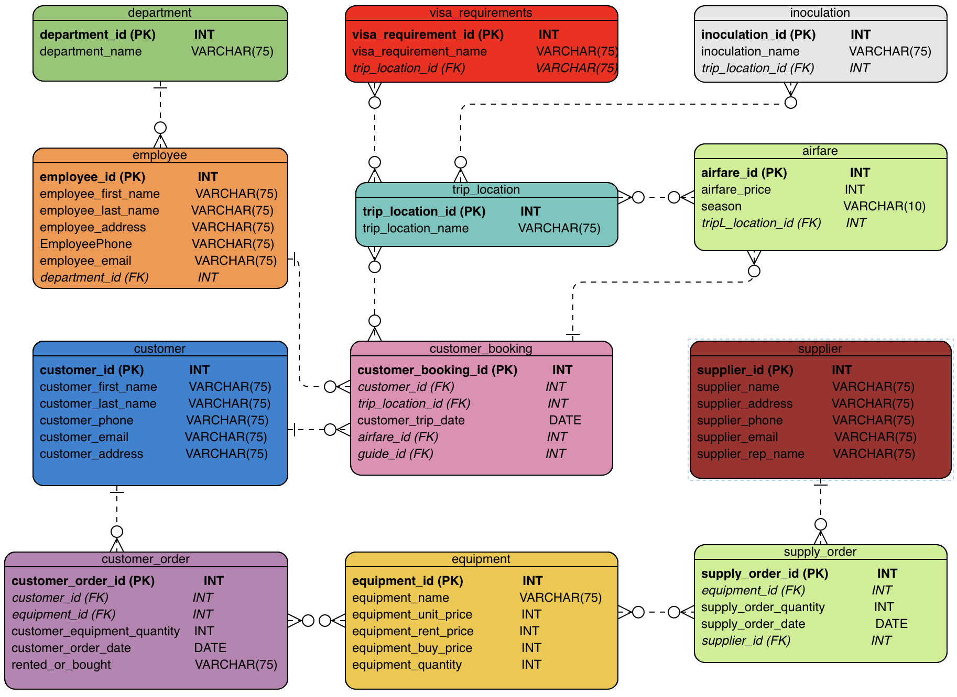
Business Rules
ERD
An EMPLOYEE is assigned to one DEPARTMENT.
A DEPARTMENT can employ many EMPLOYEES.
A CUSTOMER can purchase or rent multiple EQUIPMENT.
An EQUIPMENT can be purchased or rented by multiple CUSTOMERS.
An EMPLOYEE can be assigned to multiple CUSTOMER_BOOKINGS.
A CUSTOMER_BOOKING can have one EMPLOYEE.
A CUSTOMER can have multiple CUSTOMER_BOOKINGS.
A CUSTOMER_BOOKING has one CUSTOMER.
A CUSTOMER_BOOKING can have one AIRFARE price.
An AIRFARE price can have multiple CUSTOMER_BOOKINGS.
A CUSTOMER can have multiple CUSTOMER_ORDERS.
A CUSTOMER_ORDER has one CUSTOMER.
Notes:
the finalized ERD

Slide 8
Business Rules
ERD
A CUSTOMER_ORDER can have multiple EQUIPMENT.
An EQUIPMENT can have multiple CUSTOMER_ORDERS.
A TRIP_LOCATION can have multiple AIRFARES.
An AIRFARE can have multiple TRIP_LOCATION.
A TRIP_LOCATION can have multiple VISA_REQUIREMENTS.
A VISA_REQUIREMENT can be used for multiple TRIP_LOCATION.
A TRIP_LOCATION can have multiple INOCULATIONS.
An INOCULATION can have multiple TRIP_LOCATION.
A SUPPLIER can have multiple SUPPLY_ORDERS.
An SUPPLY_ORDER can have one SUPPLIER.
EQUIPMENTS can have multiple SUPPLY_ORDERS.
SUPPLY_ORDERS can have multiple EQUIPMENTS.
Notes:
the finalized ERD

Slide 9

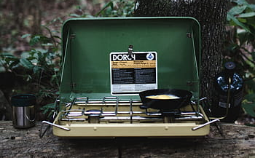
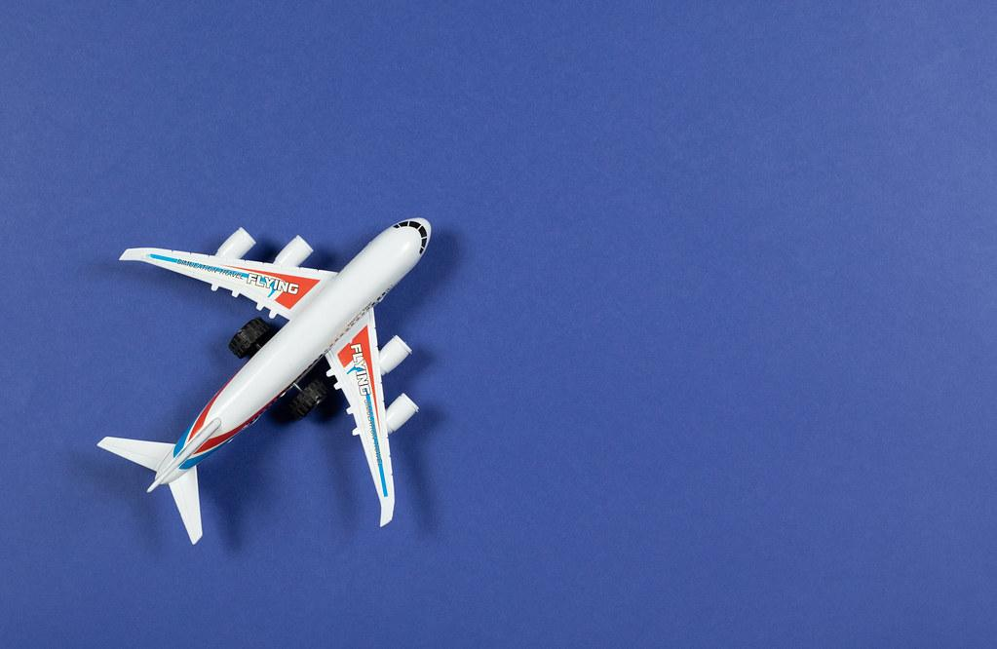
Booking Trends
REPORTS
Equipment Sales
Out of Date Inventory
01
03
02
Notes:
a description of the reports you decided to generate
an example of each report result

Slide 10
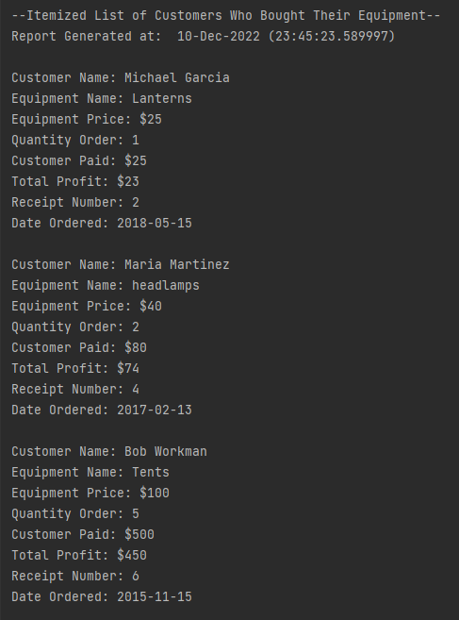
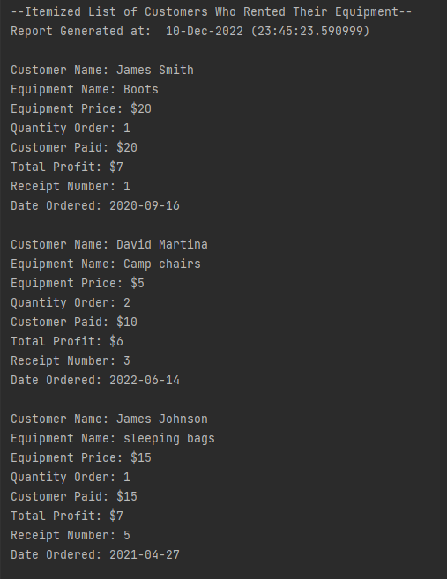
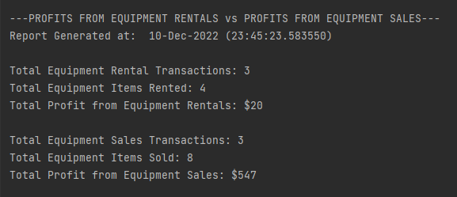
Results
Report #1:
Equipment Sales
Do enough customers buy equipment to keep equipment sales?
By joining the equipment and customer order tables we can print a report of all equipment sold and rented to customers. We assumed that displaying the difference between rental profits and purchase profits would help Blythe and Jim see if equipment sales are worth keeping.
From the results it’s clear that keeping equipment sales would be beneficial because of how much more profit it generates compared to rental profits.
Notes:
a description of the reports you decided to generate
an example of each report result

Slide 11
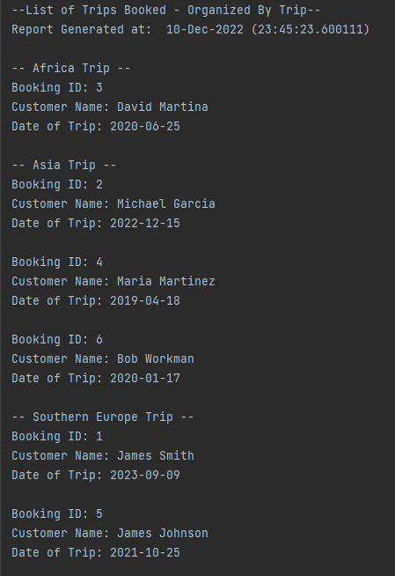
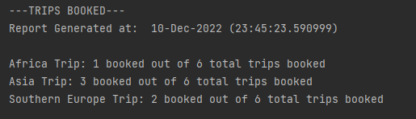
Results
Report #2:
Booking Trends
So far, Outland Adventures has conducted treks in Africa, Asia, and Southern Europe. Is there anyone of those locations that has a downward trend in bookings?
The report displays all bookings by location and a count function is used to calculate the total number of bookings by location.
We assumed that calculating the amount of bookings would make it easy to identify booking trends. With these results Blythe and Jim can identify which locations are the least popular.
Notes:
a description of the reports you decided to generate
an example of each report result

Slide 12
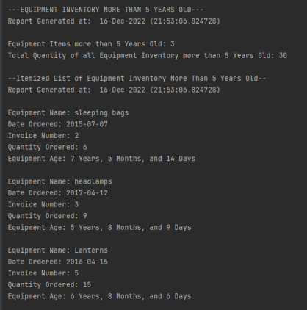
Results
Report #3:
Out Of Date Inventory
Outland Adventures is a little concerned about the age of some of the inventory. Are there inventory items that are over five years old?
By joining the equipment and supply_order table we created a table displaying equipment with an order date of over 5 years old.
The results show which equipment is out of date, so they can see how much equipment needs to be replaced.
Notes:
a description of the reports you decided to generate
an example of each report result

Slide 13

Thank you.
References
Comeau, A. (2018). MySQL explained: Your step-by-step guide to database design (Revised edition). CA : OSTraining.
Forta, B. (2020). Sams teach yourself SQL in 10 minutes (Fifth edition). Sams, Pearson Education.
Python: How to get Current date and time or timestamp ? – thisPointer. (n.d.). Retrieved December 10, 2022, from https://thispointer.com/python-how-to-get-current-date-and-time-or-timestamp/

